Slide 1
IMDB Movie Analysis
Zaid Mohammad

Slide 2
Project Description
In this project, we study IMDb movie data to find out what makes a movie successful. We analyze different factors like genres, durations, languages, directors, and budgets to see how they affect movie ratings and profits. Using Excel, we clean the data, calculate statistics, and create charts to spot patterns. The goal is to gain insights that can help filmmakers make better decisions for future movies.

Slide 3
Tech Stack
MS - Excel
PowerPoint

Slide 4
Data Cleaning
Removed Empty Rows and Columns:
Got rid of rows and columns that had no data at all.
Standardized Column Names:
Made all column names lowercase.
Replaced underscores (_) with spaces to make them easier to read.
Handled Missing Values:
For numbers, filled missing values with the middle value (median).
For words/categories, filled missing values with the most common one.
Deleted rows that had too much missing data.
Corrected Data Types:
Fixed the num user for reviews column so it’s properly recognized as a number..
Removed Duplicates:
Deleted any repeated rows to avoid duplicates.
Formatted Text Columns:
Removed extra spaces at the end of movie titles.
Capitalized the first letter of each word in the genres.

Slide 5
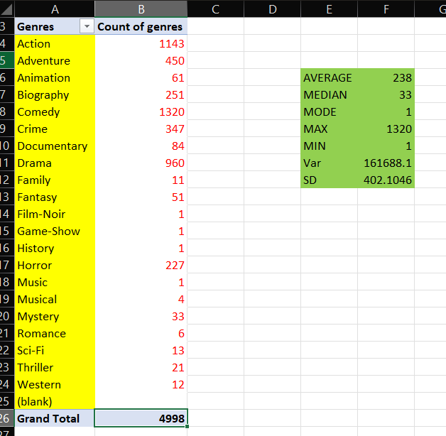
Data Analytics Tasks
A. Movie Genre Analysis:
Insights : Comedy genre has the most movies which comes to a total of 1320 movies while as Noir, Game-Show, History and Music are the genre with the least number of movies that is 1 per genre.

Slide 6
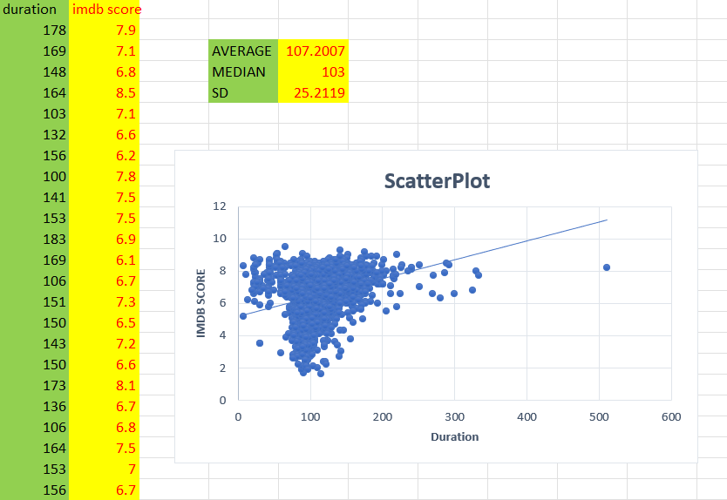
B. Movie Duration Analysis:
Insights :
The average watch time turned out to be 107.2007 The median being 103 The standard deviation is 25.2119

Slide 7
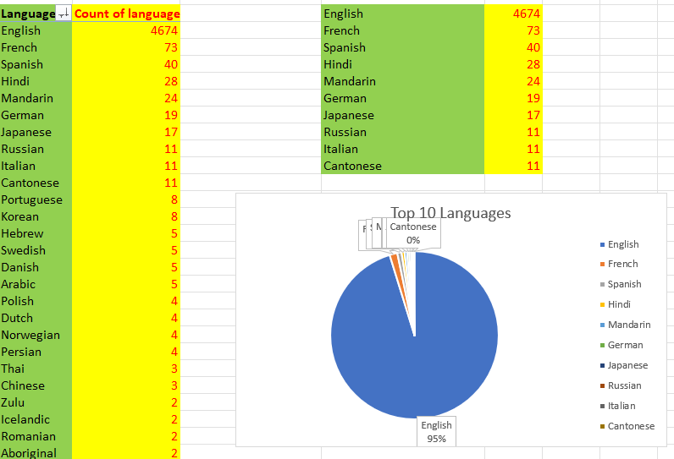
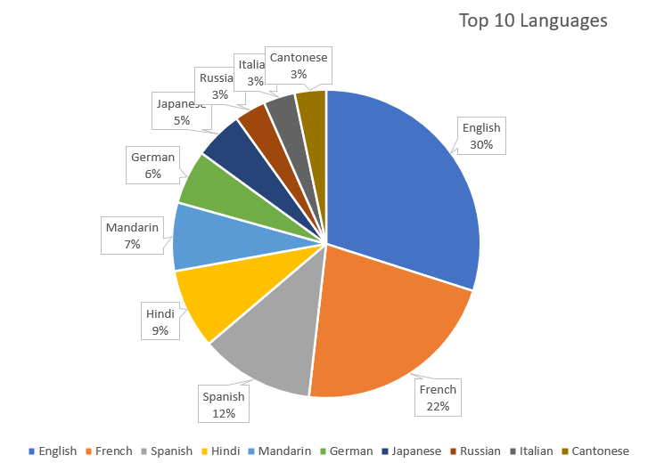
C. Language Analysis
Insights :
The most common languages used in movies are English followed by French and then Spanish. As the Pie Chart show that 95% of the movies used English as their language.
Note : In the figure on the left we replaced the original count of English that is 4674 by 100 for a better graphical view to compare it with the other top languages.

Slide 8
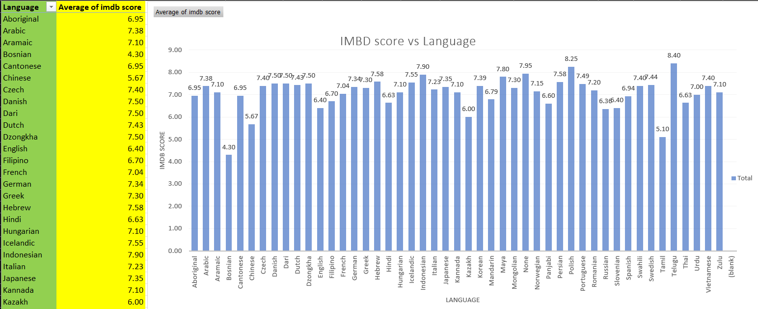
Relationship between IMDB scores and Languages
Insights :
The languages with the highest average IMDB score (and above 8.0) are Telegu with a rating of 8.4 followed by Polish at 8.25 while the languages with the lowest average IMDB score (and below 5.5) are Tamil with a rating of 5.1 followed by Bosnian at 4.30. English (most common language) scores exactly at the midpoint: 6.40
Chinese films have the lowest average among major languages: 5.67
Bosnian films show the lowest overall average: 4.30
Many European languages (French, German, Italian) score consistently high (7.0+)

Slide 9
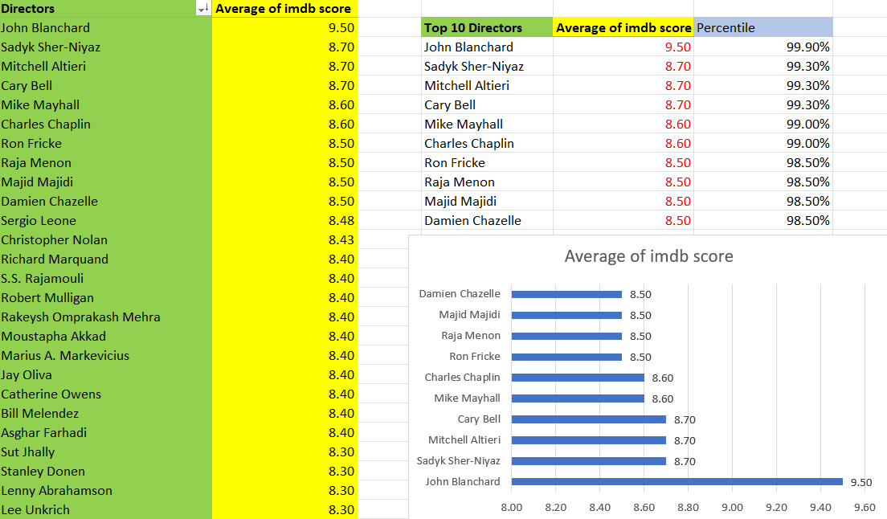
D. Director Analysis:
Insights :
Best Director: John Blanchard has the highest IMDB score of 9.5, making him the top-rated director.
Other Great Directors: Sadyk Sher-Niyaz, Mitchell Altieri, and Cary Bell have 8.7 scores, putting them in the top group.
Charles Chaplin also scores high with 8.6, showing he still impresses viewers.
Directors with 8.5+ scores make super popular movies that people really like.

Slide 10
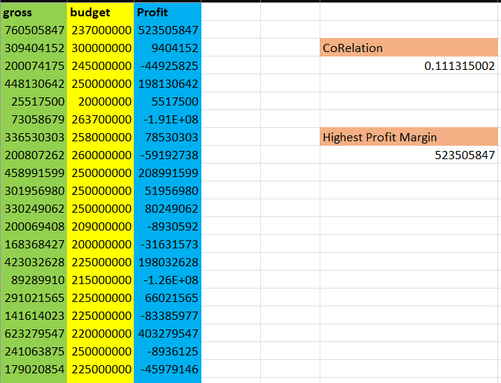
E. Budget Analysis
Insights :
The correlation between the budget and profit is 0.1113, indicating a weak relationship.
The highest profit margin(Max) observed is 523,505,847, which represents the most financially successful movie in the dataset.
Despite the high budgets, some movies still incurred significant losses, as shown by the negative profit values.

Slide 11
Insights
Genre Impact:
Some genres consistently have higher ratings, while others are rated lower.
Drama and thriller movies often score higher, while niche genres may have mixed ratings.
Movie Duration:
Medium-length movies (around 90-120 minutes) tend to have the best ratings.
Extremely short or long movies often receive lower scores.
Language Influence:
English-language movies dominate the dataset and generally have higher ratings.
Less common languages show varied ratings, indicating niche appeal.
Director’s Impact:
Certain directors consistently produce high-rated movies.
Top-rated directors have a major influence on a movie's success.
Budget vs. Earnings:
Movies with higher budgets generally earn more, but this doesn’t guarantee high ratings.
Some low-budget movies achieve higher profits, showing that creativity and content matter.
Excel Sheet Link - https://docs.google.com/spreadsheets/d/1oXg3_5qnEE5M4yF6oON91H57YFL7rOAt/edit?usp=sharing&ouid=110673356967982932629&rtpof=true&sd=true

